Slide 1


Slide 2
T-Shirt E-Commerce Web App
Project Contributors Members
Tanzeela Ghafoor
Kashaf Akram
Tayyiba Sohail

Slide 3
Web Technologies
Frontend
React.js
Backend
Node.js
Express.js
MongoDB

Slide 4
Introduction
A web-based platform for buying T-shirts with categories for Men, Women, and Kids.
Users can view product details, add items to the cart, and complete the purchase
The platform provides a seamless shopping experience, allowing users to explore product details, add items to their cart, and complete their purchase with ease
Our platform incorporates secure authentication methods to protect user data and ensure a safe shopping experience

Slide 5
Key Features
Home Page
Product Detail Page
Cart System
User Authentication
Admin Dashboard

Slide 6
Home Page
Easy access to product categories like Men, Women, Kids, and the shopping cart, ensuring smooth browsing for users
The "New Collections" section highlights the latest arrivals, making it easy for users to view the newest products as soon as they become available
A subscription form invites users to sign up for exclusive deals, enhancing user engagement and building a customer base.

Slide 7
Product Details Page
The product details page showcases the 'Men Long Sleeve Basic T-shirt' with a large product image, detailed description, price, and customer ratings
Users can select their preferred size through clickable buttons and add the product to the cart easily
Includes customer ratings, reviews count, and price for quick reference
Allows users to quickly add selected products to the cart, ensuring a smooth checkout process without leaving the product page

Slide 8
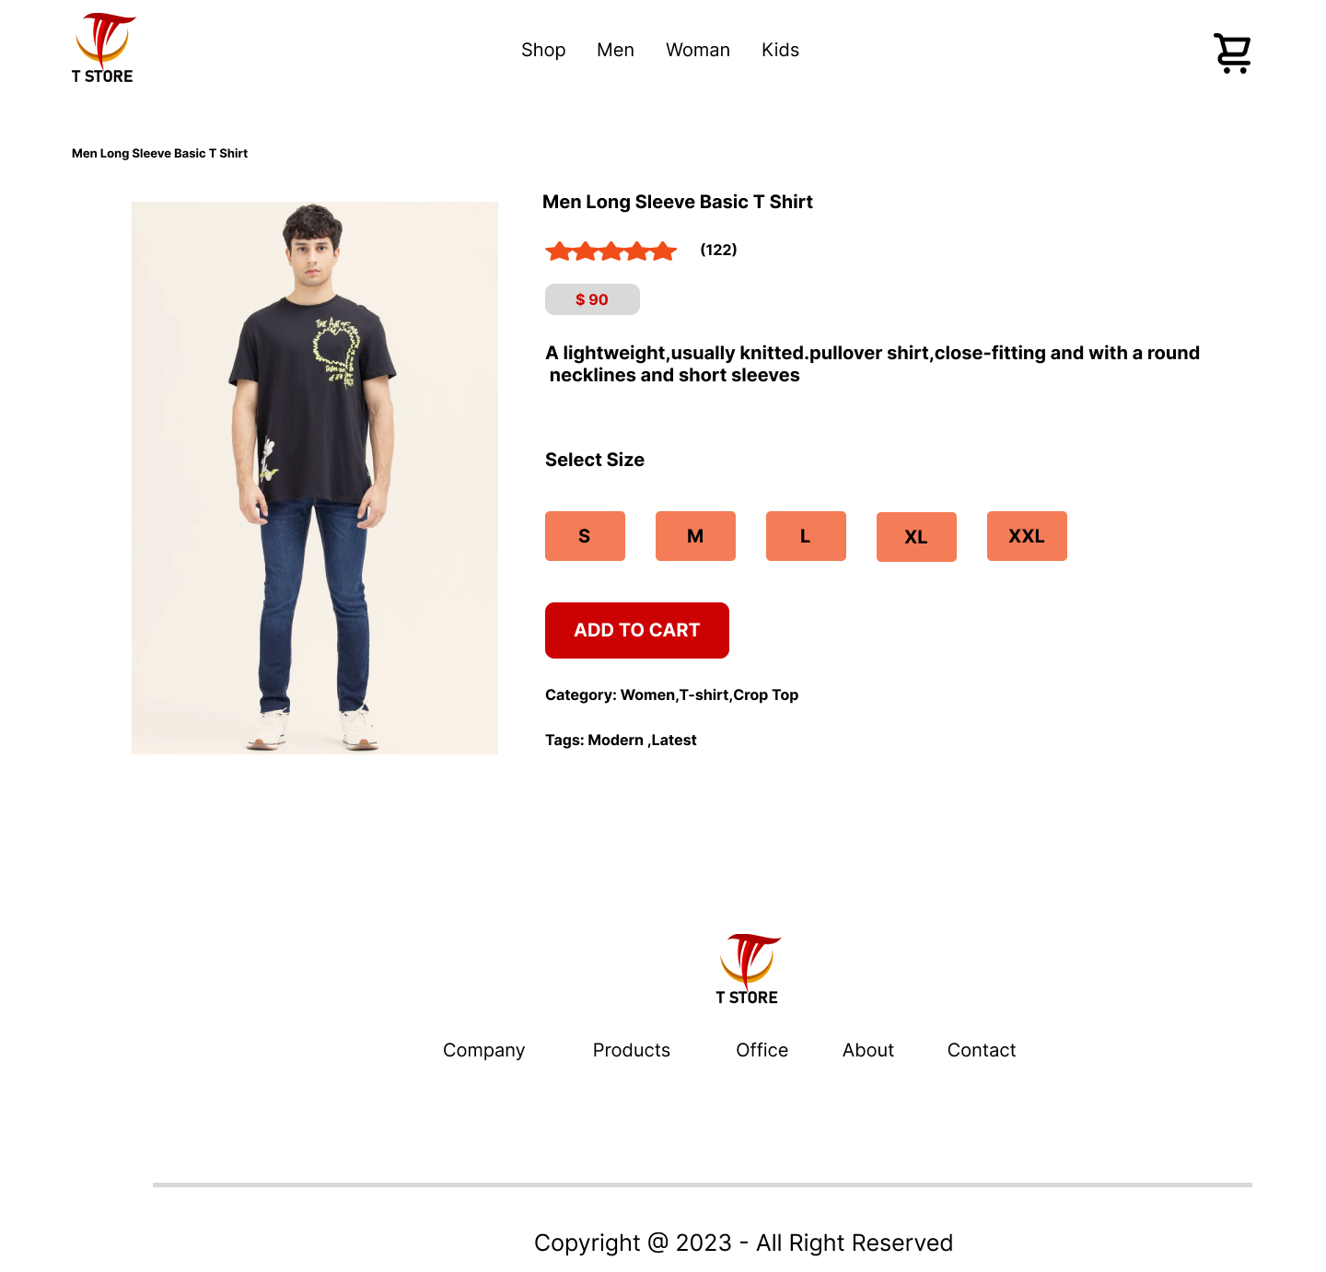

Slide 9
Shopping Cart
This page displays a summary of the selected products, their quantities, and total costs
The user can review their selected items, adjust quantities, and see updated totals before proceeding to checkout
he cart totals section breaks down the subtotal, shipping fees, and the grand total, with a bold "Proceed to Checkout" button for the final step

Slide 10
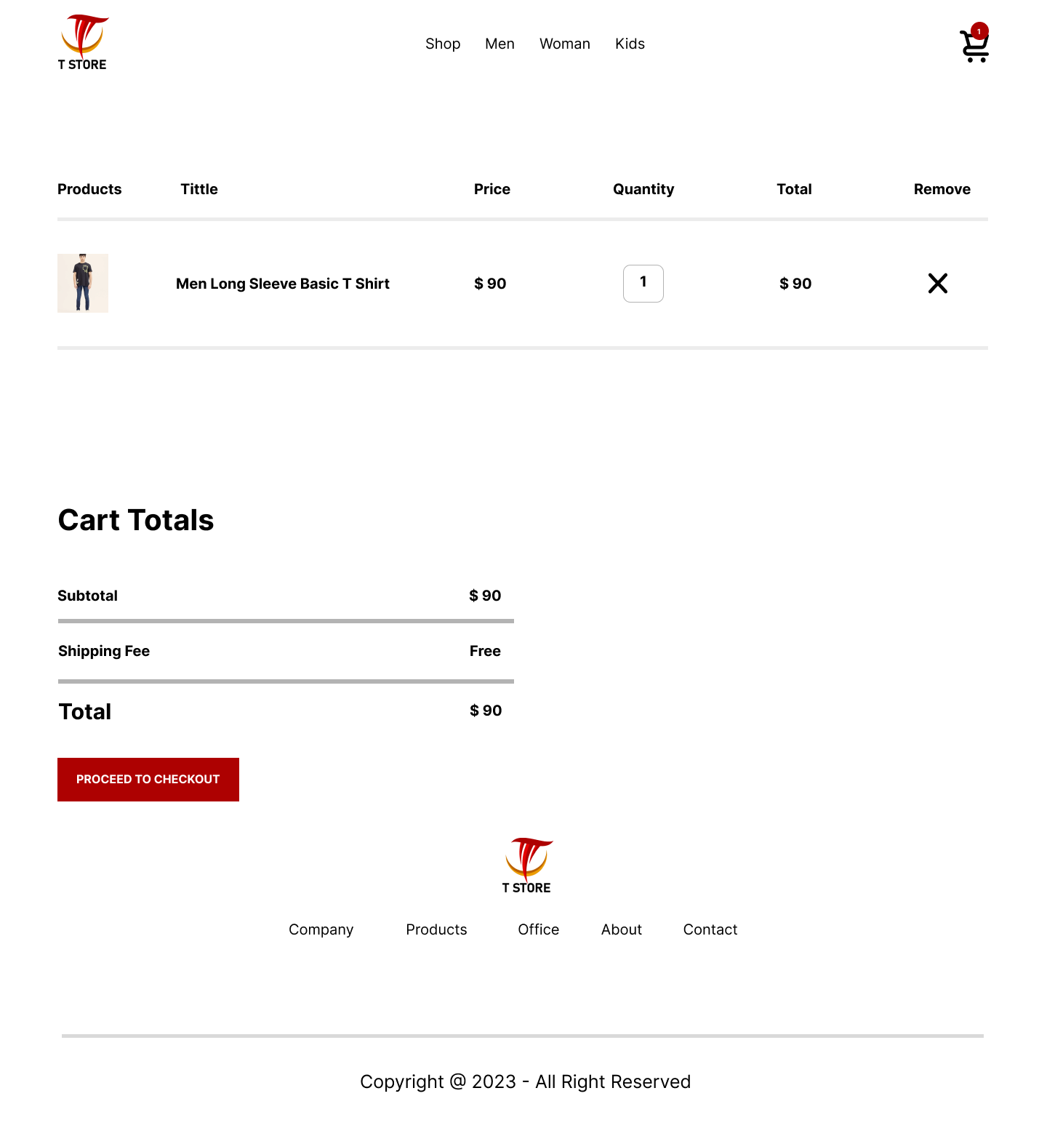

Slide 11
Authentication System
Signup Form
our platform incorporates secure authentication methods to protect user data and ensure a safe shopping experience
The user must fill out all required fields (name, email, password) correctly before being allowed to proceed
A privacy policy is crucial for informing users about how their data will be collected, used, stored, and protected when they sign up

Slide 12
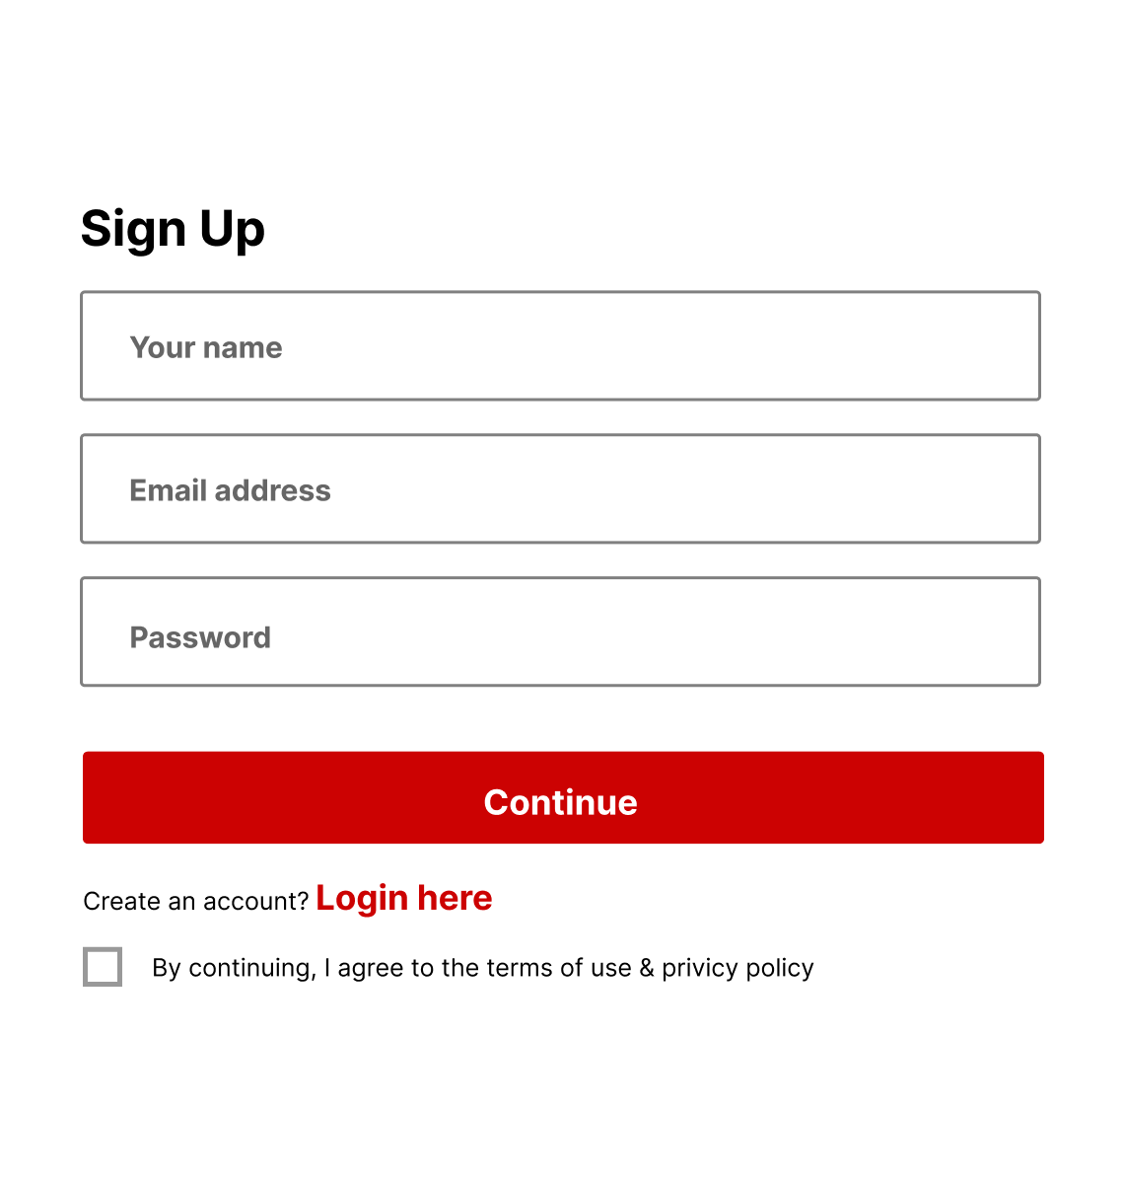

Slide 13
Login Form
If the user has already signed up, they can simply log in using their credentials (email address and password) in the provided fields without needing to create a new account
To log in, the user must enter their email address and password, then click the "Continue" button to proceed. If the credentials are correct, the user will be successfully logged in

Slide 14
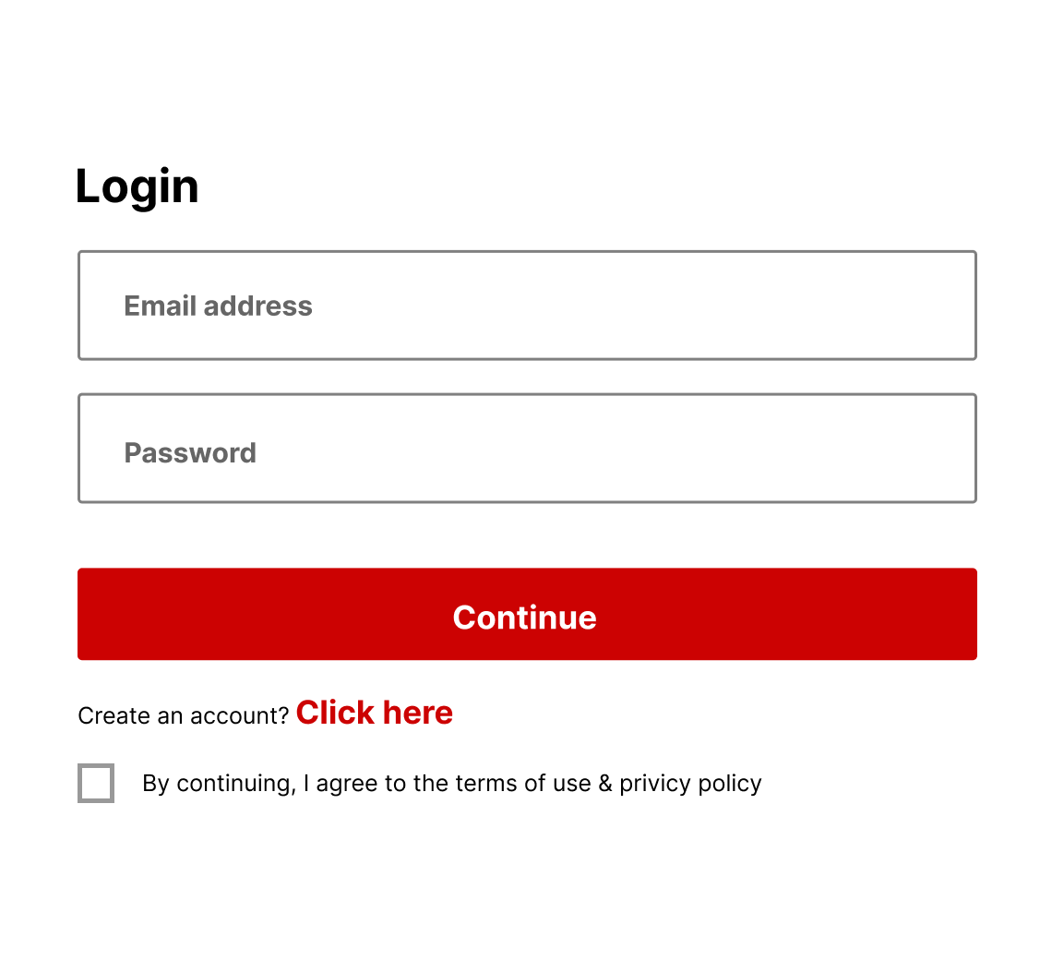

Slide 15
Thank you

